Slide 1

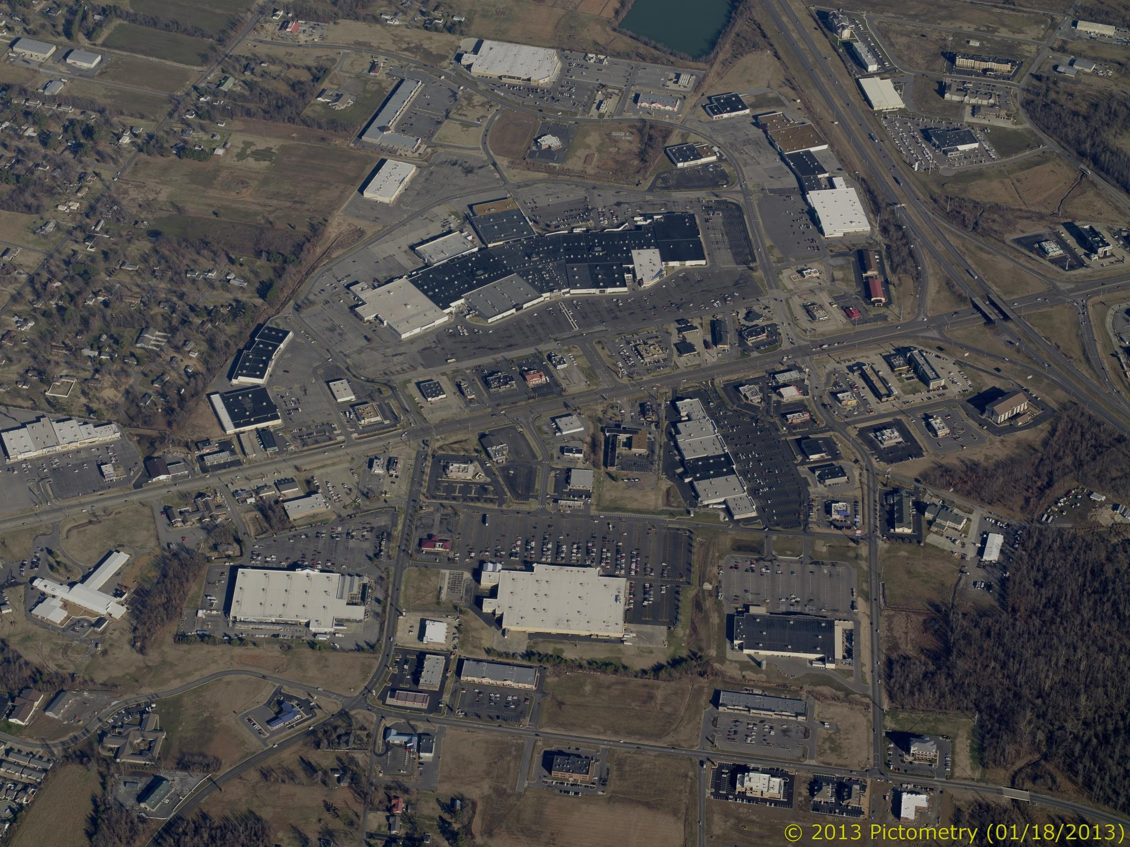



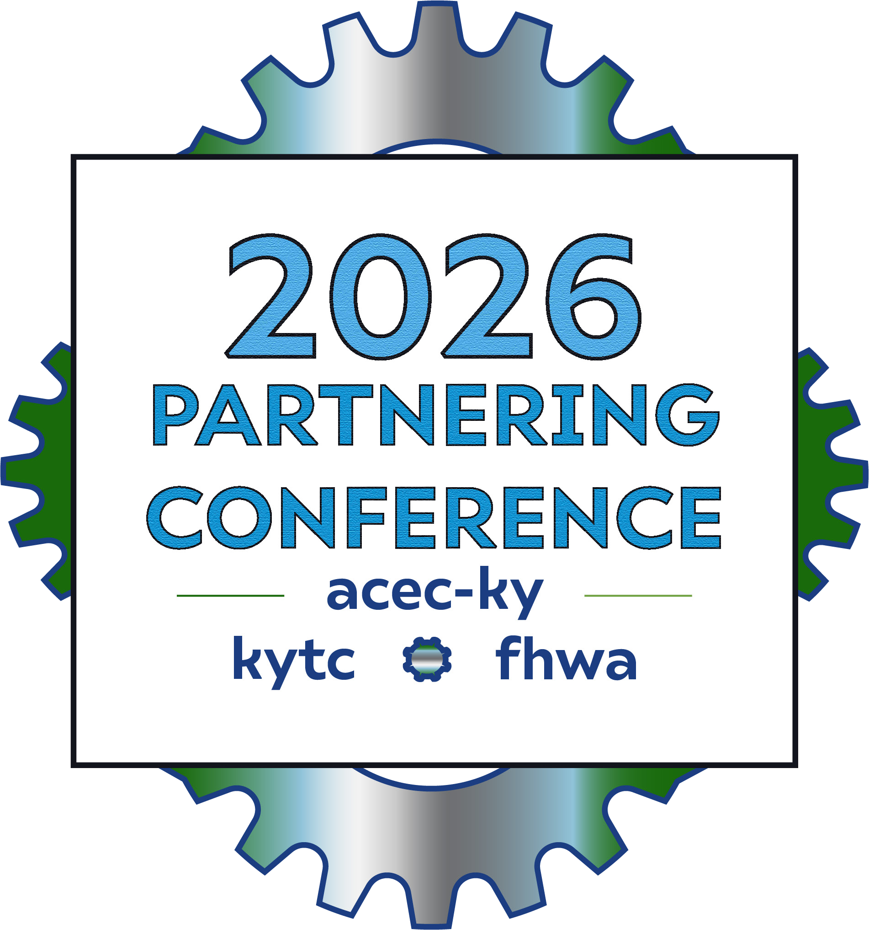
Thinking Beyond the Intersection and Project Limits
Austin Hart, KYTC District 1
Brian Aldridge, Stantec

Slide 2


Agenda
Project History
Before and After Construction
Lessons Learned

Slide 3

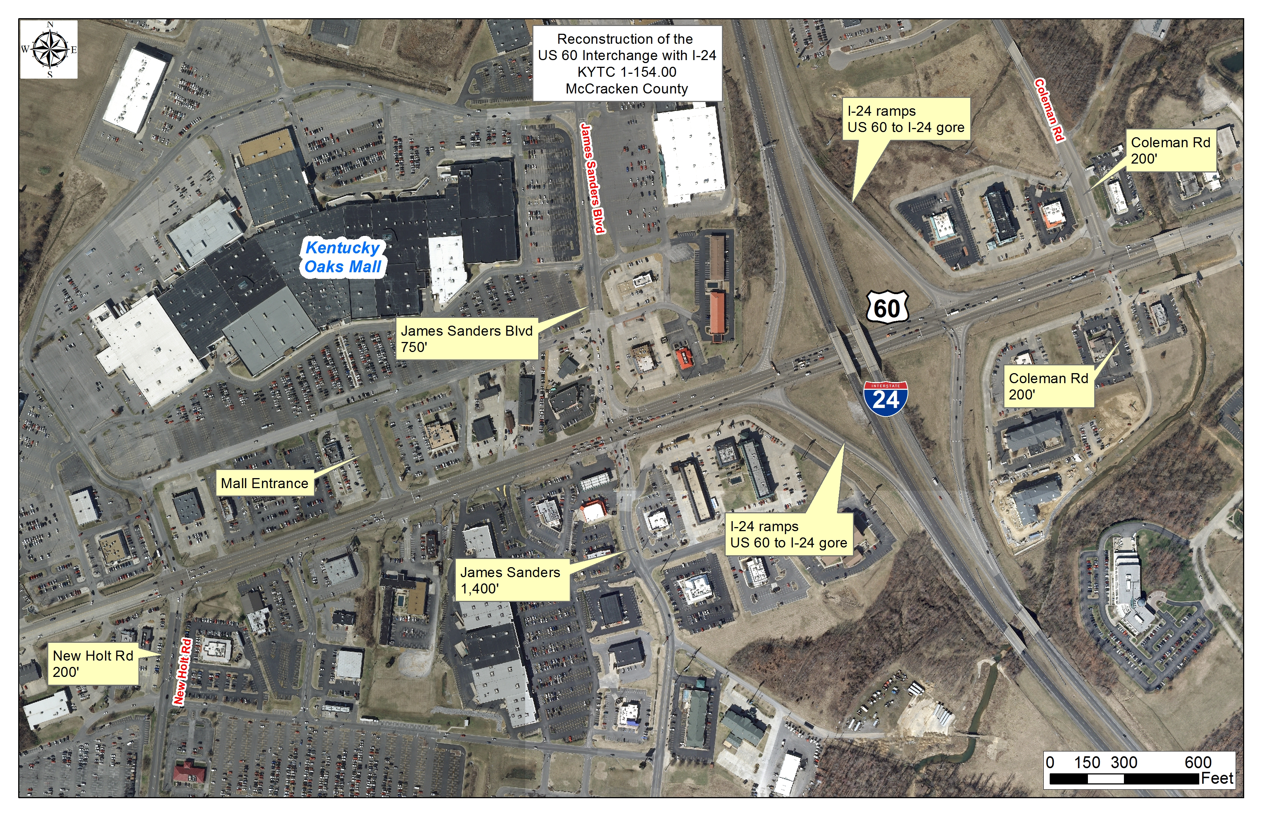

Slide 4



Slide 5


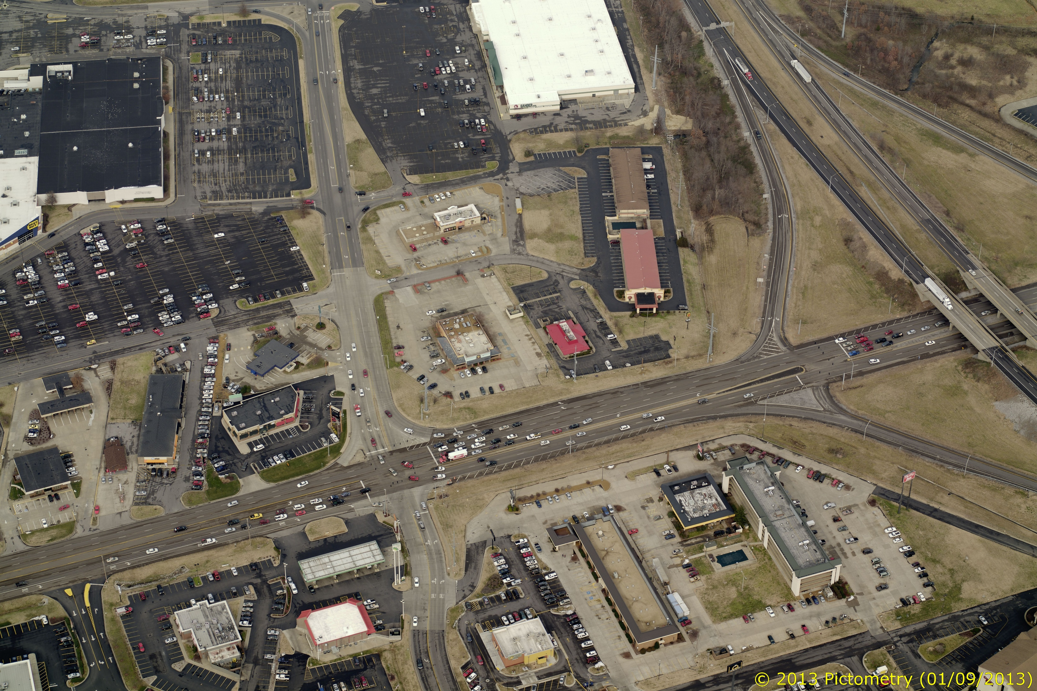
West of the Interchange
Kentucky
Oaks
Mall
James Sanders
~600’

Slide 6
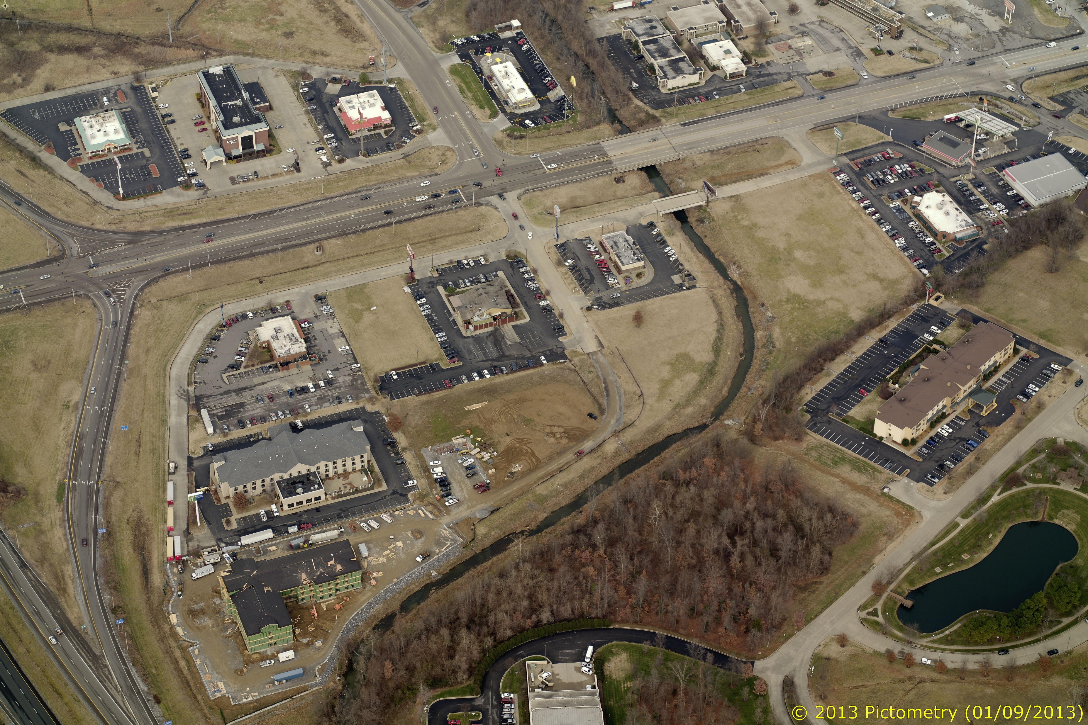
East of the Interchange
~620’
Perkins Creek
Coleman Road

Slide 7

At the Interchange
~100’

Slide 8
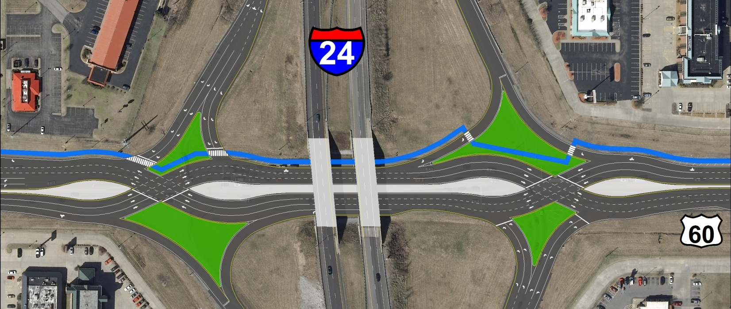
2012 Scoping Study
US 60 Scoping Study recommended a Double Crossover Diamond (DCD) interchange
2022 Design Year (10-year)

Slide 9
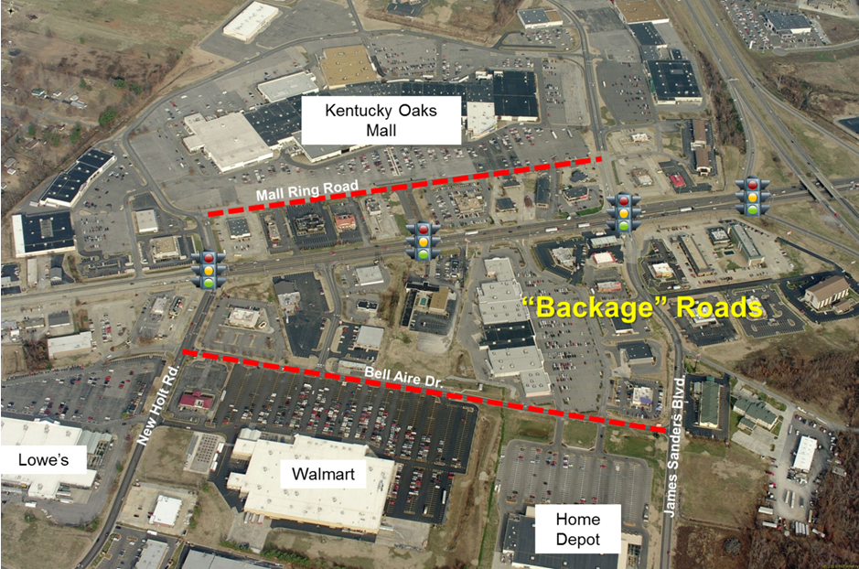

Slide 10
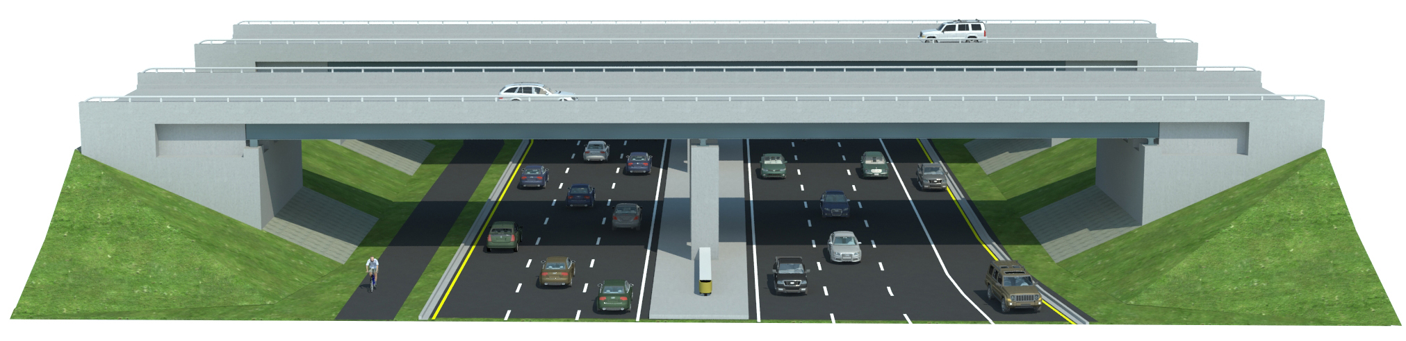
Preliminary Concept
Proposed Beneath I-24
10’
20’
11’
11’
11’
11’
11’
11’
11’
Approximately 100’

Slide 11
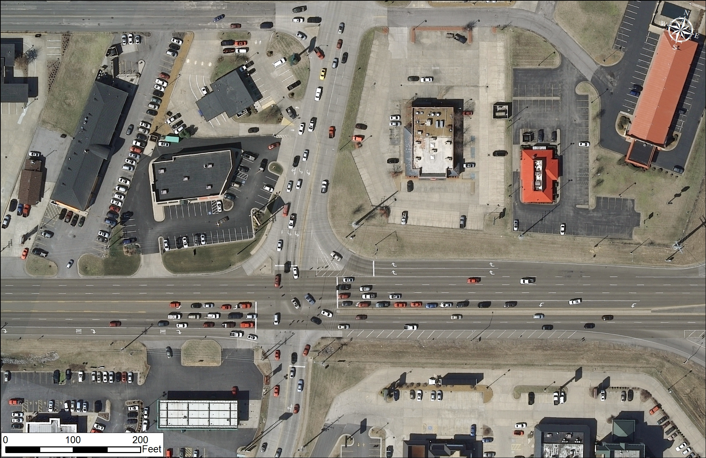
James Sanders Boulevard
James Sanders

Slide 12
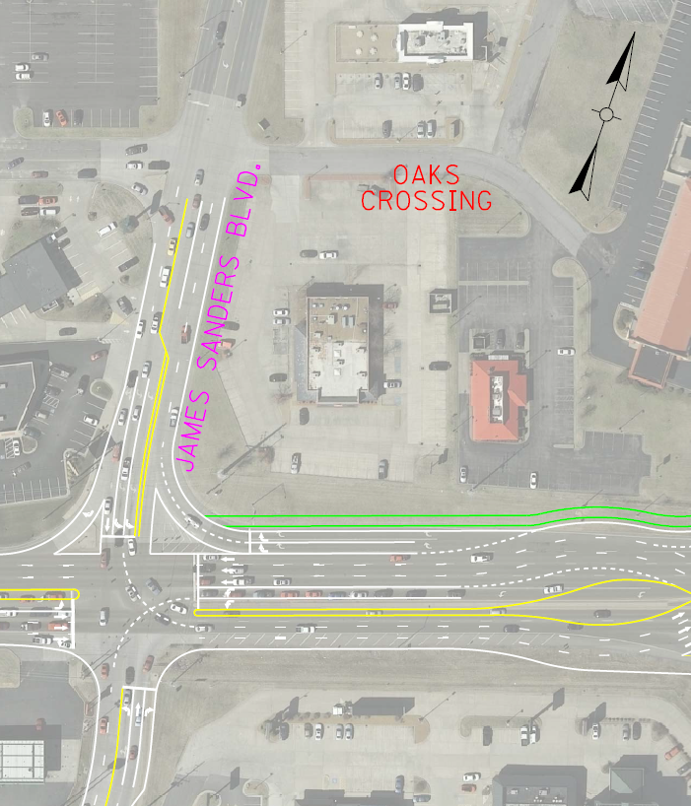
James Sanders
Boulevard
Dual right turn lanes (original configuration)

Slide 13
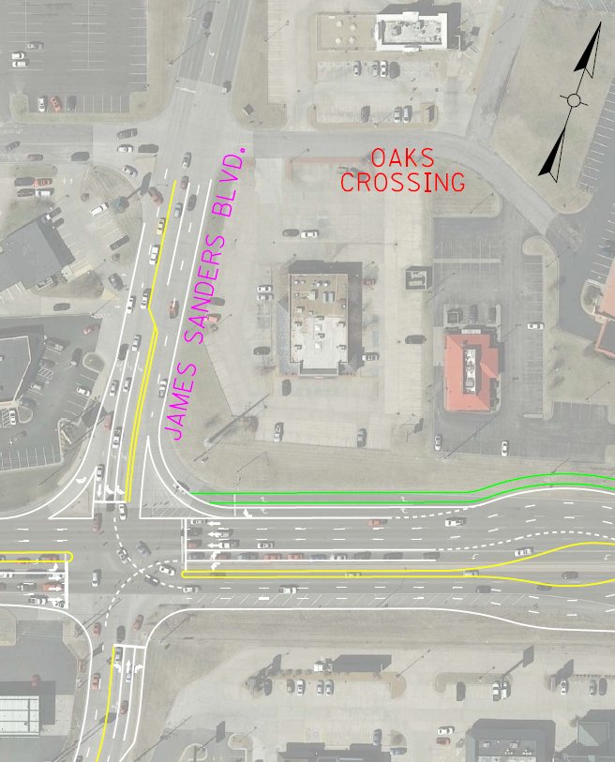
James Sanders
Boulevard
Single free flow right with no changes to James Sanders

Slide 14
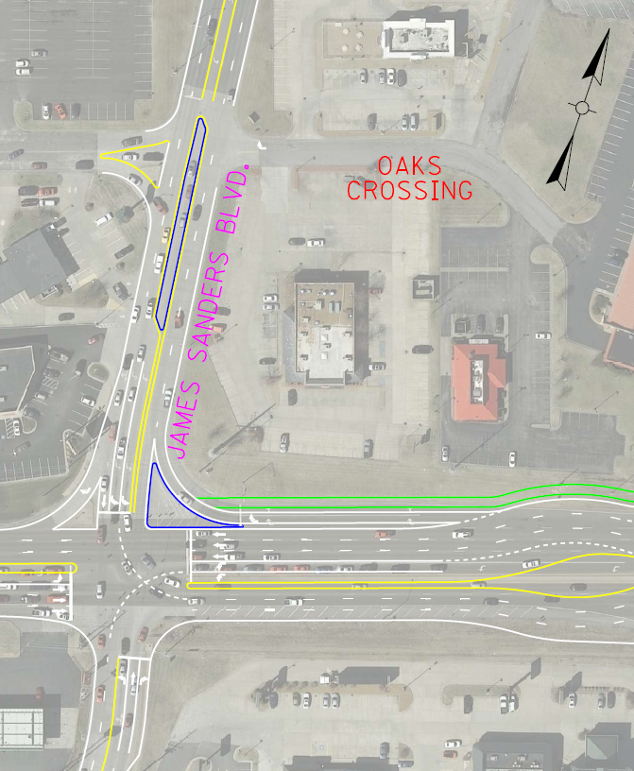
James Sanders
Boulevard
Single free flow right with proposed access management

Slide 15
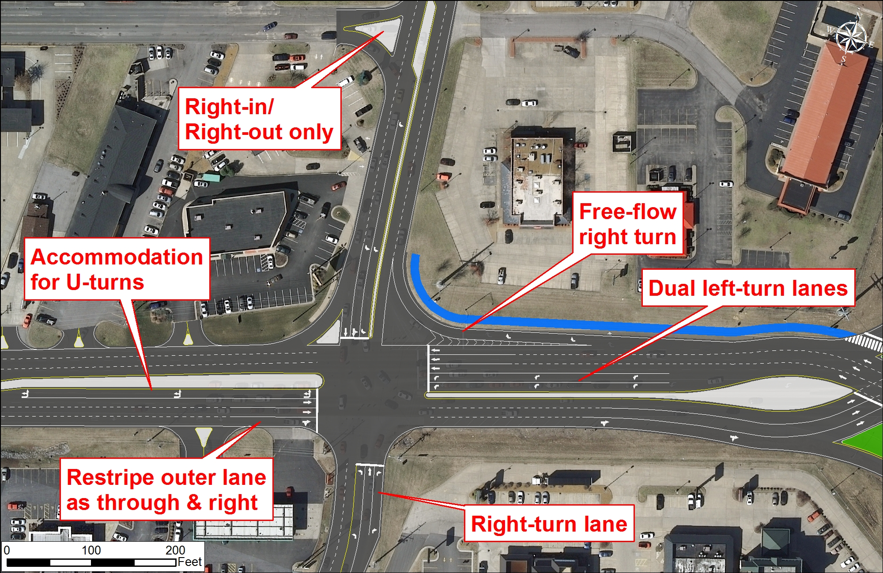
James Sanders Boulevard
James Sanders

Slide 16
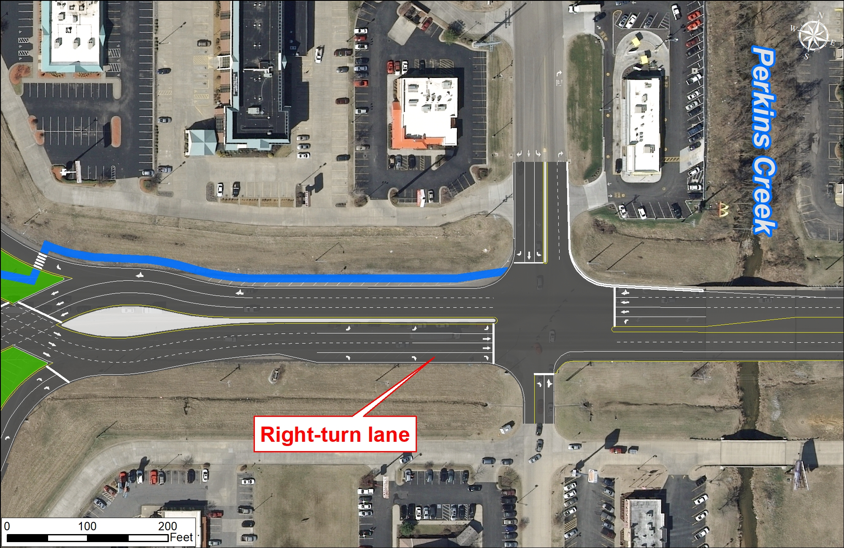
Coleman Road
Coleman Road

Slide 17
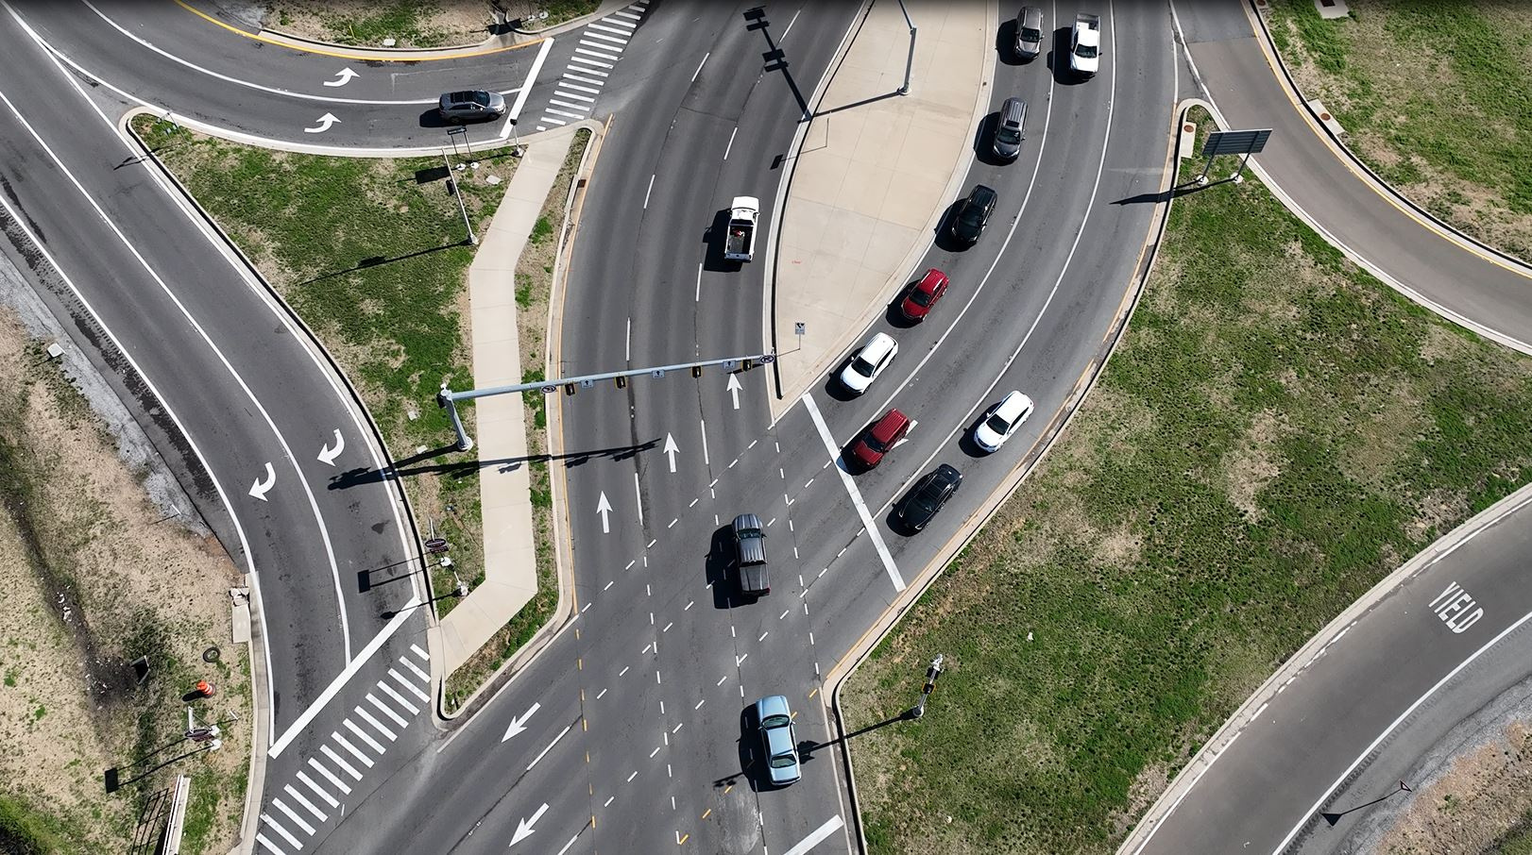
Construction

Slide 18
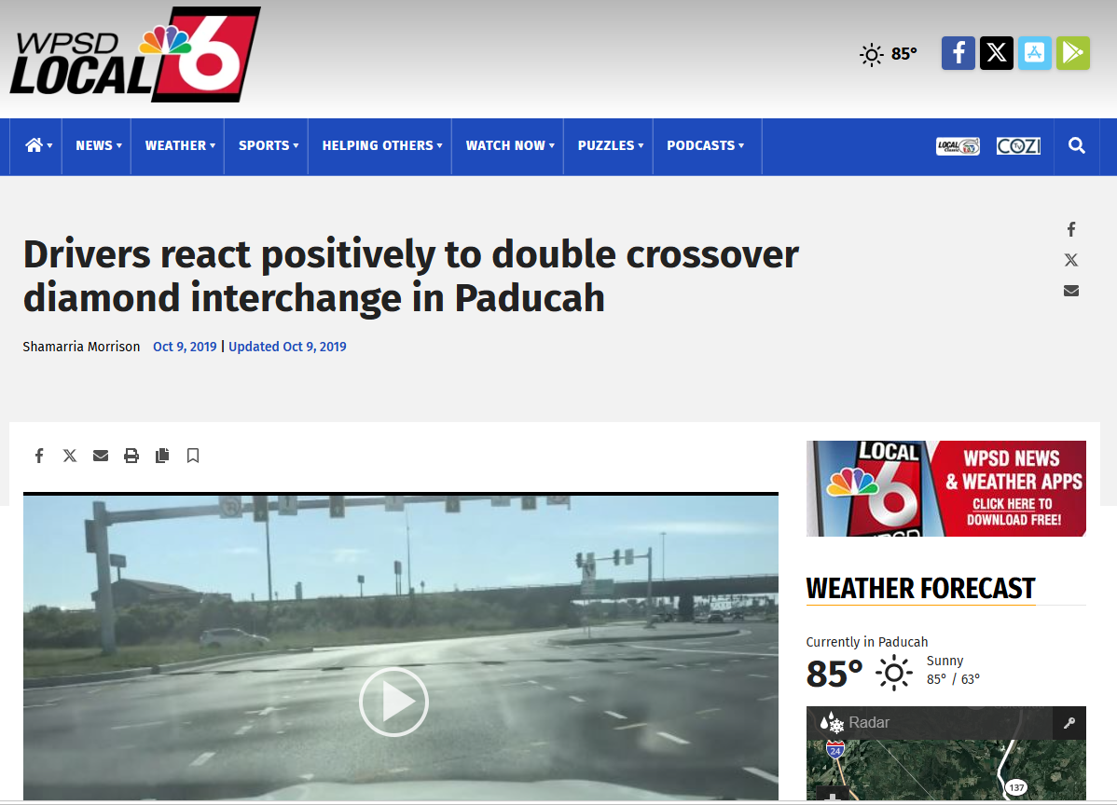
Public & Business Reaction
"It was kind of odd at first, because you're switching sides, but I'm used to it," said Phillip Barnett. "I love it.“
"I can remember trying to get through the traffic prior to it being built, and it seems like this is a whole lot speedier. It's faster," Barnett said.
Source: www.wpsdlocal6.com

Slide 19

2017 2024
QDOBA
Jimmy John’s
Starbucks
Freddy’s
Pizza Hut
Cheddars /
Chuy’s

Slide 20
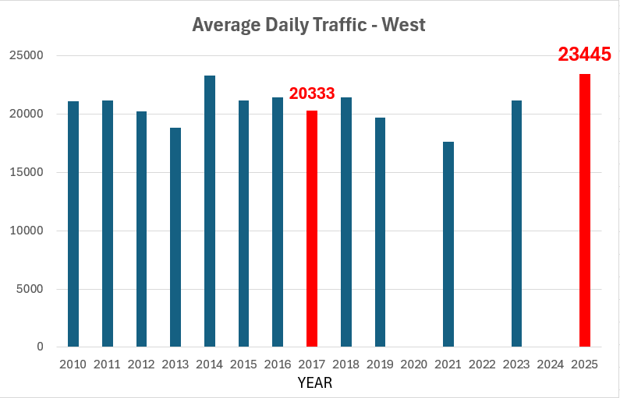
Daily Traffic (in Vehicles per Day)
+15%

Slide 21


Travel Speeds
Route | Direction | Location | Average Hourly Speed (mph)
 |  |  | 2017 | 2018 | CONSTRUCTION | 2021 | 2022 | 2023
US 60 | EB | West of interchange | 22.5 | 23.0 |  | 23.3 | 24.4 | 21.9
 |  | Through interchange | 20.0 | 20.1 |  | 16.8 | 16.5 | 16.6
 |  | East of interchange | 30.3 | 30.8 |  | 25.5 | 28.5 | 29.8
 | WB | East of interchange | 30.8 | 30.8 |  | 25.7 | 27.1 | 27.9
 |  | Through interchange | 21.5 | 21.8 |  | 14.6 | 14.9 | 14.1
 |  | West of interchange | 24.8 | 25.6 |  | 20.3 | 21.0 | 20.5

Slide 22
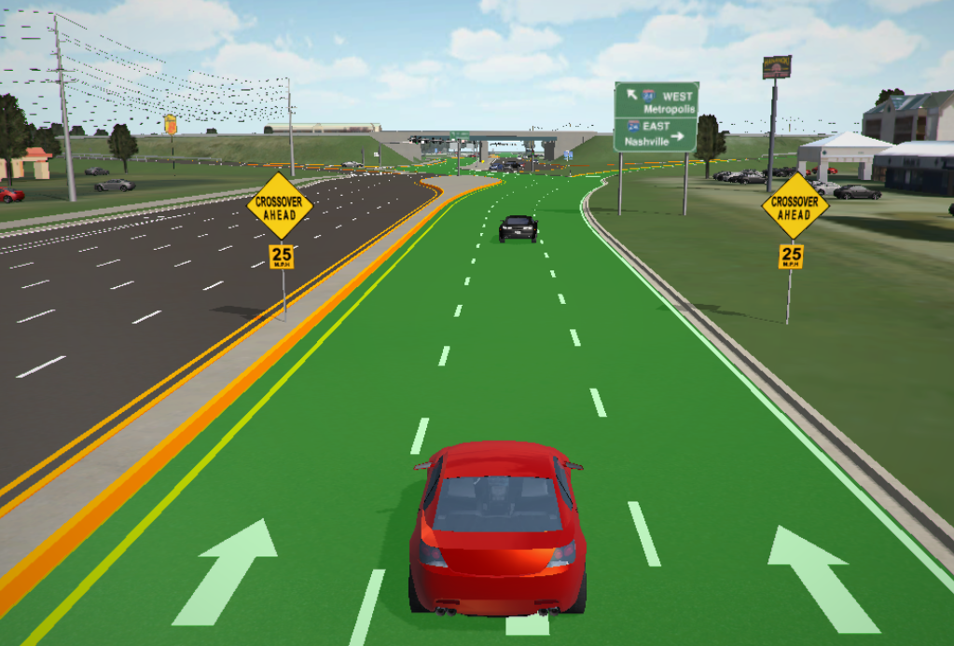
Travel Speeds (by Design)

Slide 23
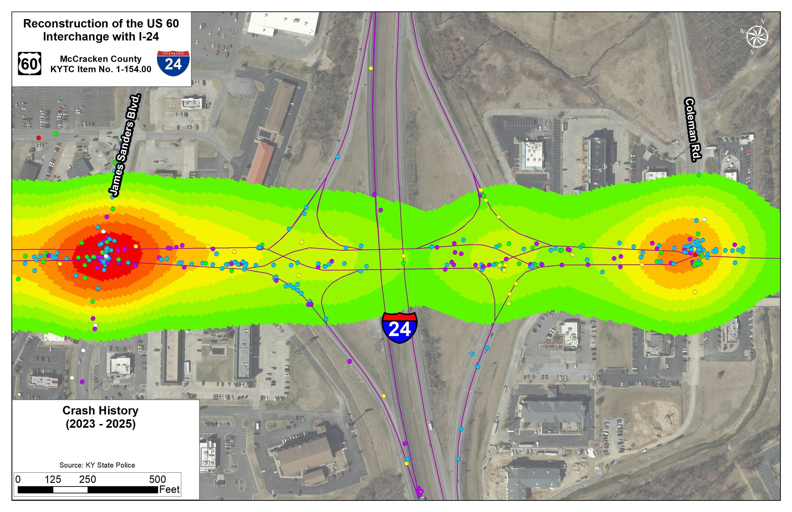
Crash Experience
2016 - 2018
  437 Crashes
  54 Injury (12.4%)
2023 - 2025
  374 Crashes
  45 Injury (12.0%)
  -15% reduction overall
  -30% at ramps

Slide 24
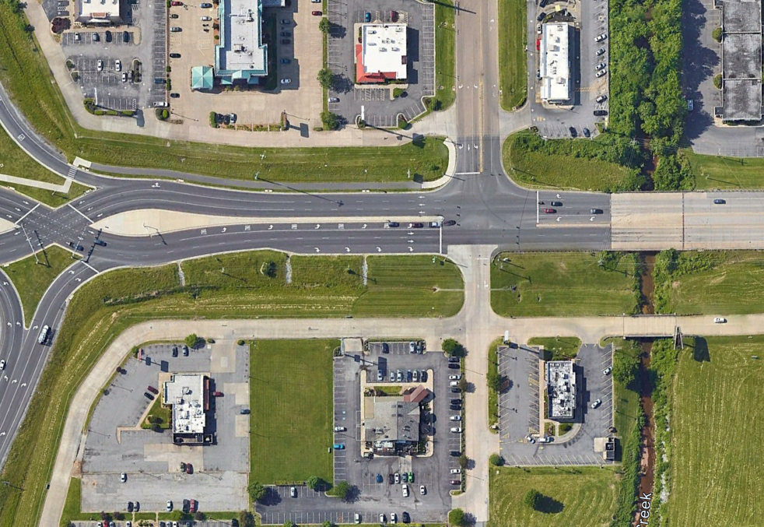
Crosswalk Request
Perkins Creek
Coleman Road

Slide 25
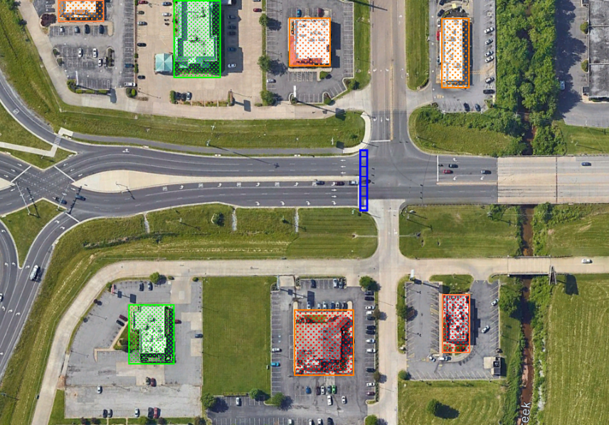
Hotel
Restaurant
Restaurant
Hotel
Restaurant
Restaurant

Slide 26
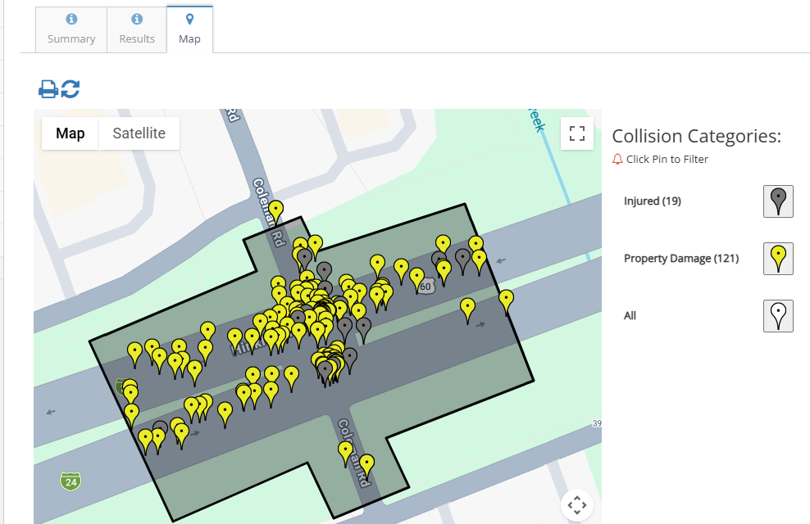
Coleman Road: 2021-2025
140
Reported Collisions
19
injury-involved collisions
29
total reported injuries
121
property-damage collisions
3
commercial-vehicle collisions
0
fatalities
4
Notes:
[Sources]
- User-provided crash-history document, Coleman Road summary screenshot and map screenshot.
- Derived share: 19 injury-involved collisions / 140 total collisions = 13.6%.
[/Sources]

Slide 27
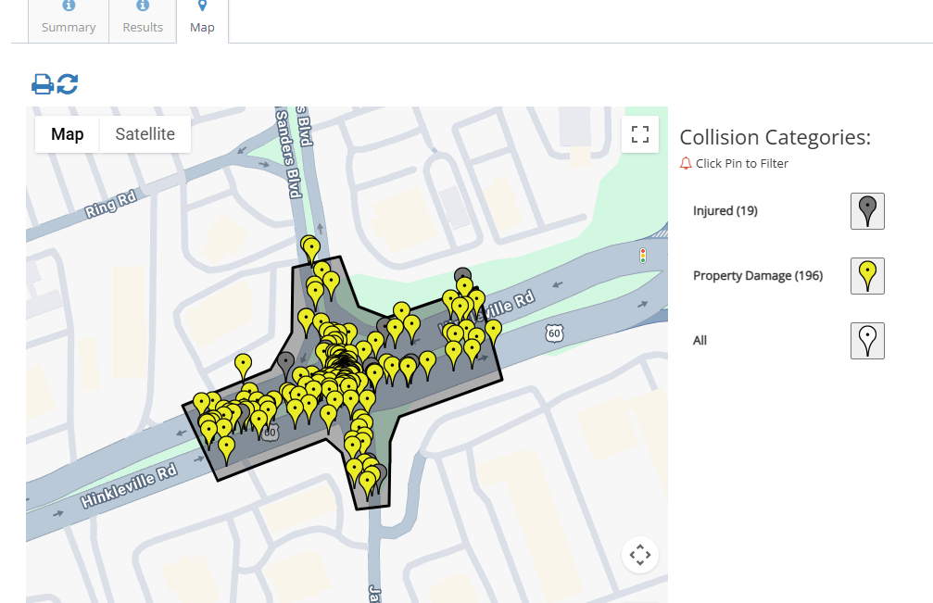
James Sanders: 2021-2025
215
Reported Collisions
19
injury-involved collisions
20
total reported injuries
196
property-damage collisions
3
commercial-vehicle collisions
0
fatalities
Notes:
[Sources]
- User-provided crash-history document, James Sanders Boulevard summary screenshot and map screenshot.
- Derived share: 19 injury-involved collisions / 215 total collisions = 8.8%.
[/Sources]

Slide 28
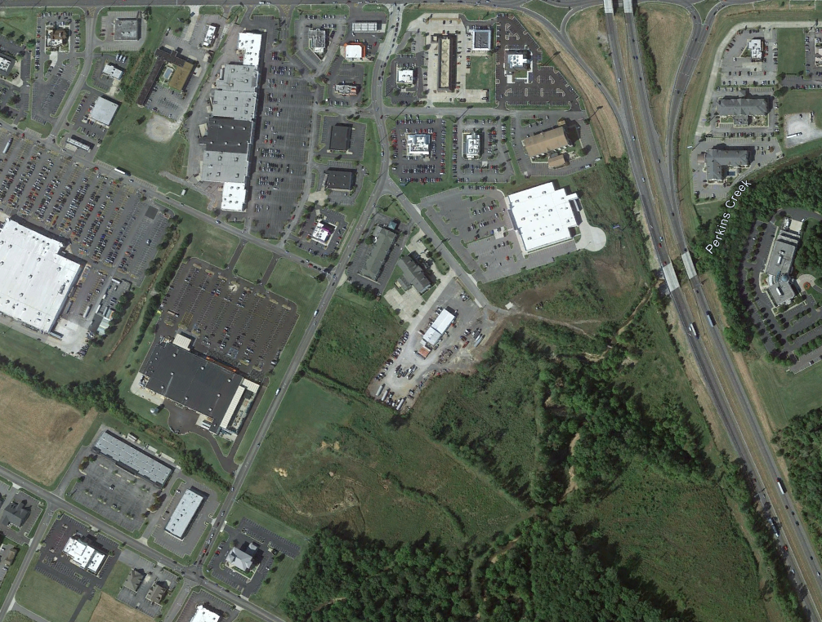
James Sanders South of US 60
Cheddars / Chuy’s
City Streets - Pecan Drive, Village Square, Bell Aire Drive
New Business –Restaurants, Dr. Offices, Home Improvement Stores
Commuter Traffic avoiding Interstate 24
Bell Aire Dr
Academy (2017)
Coleman Road
Village Square
Doc. Office

Slide 29
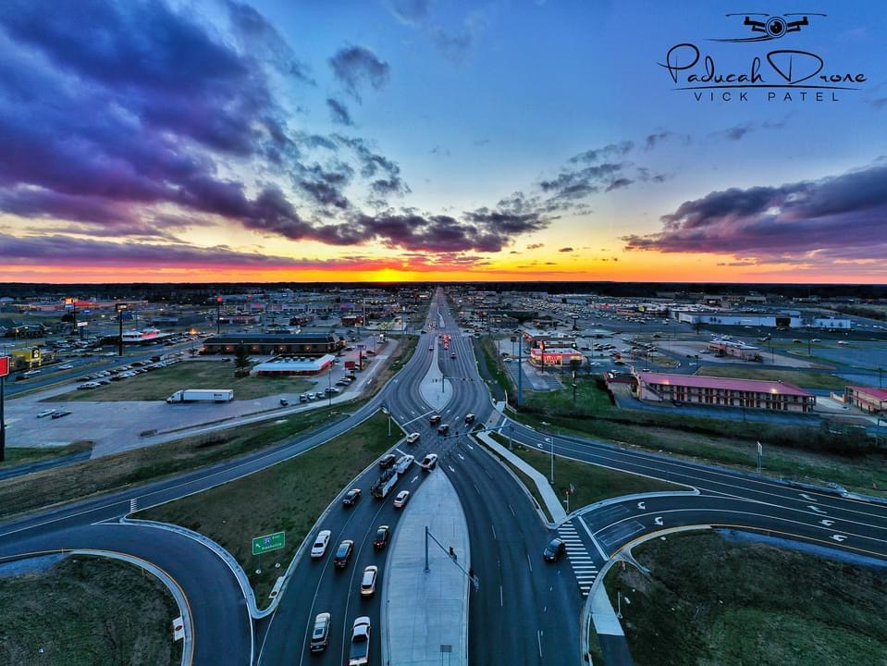
Conclusions
Consider all available Data
Design Year: 5 -10 years versus 25 years
Considering Traffic Generators
Permit Guidance to City / County Planners
How soon do we revisit the same area?

Slide 30
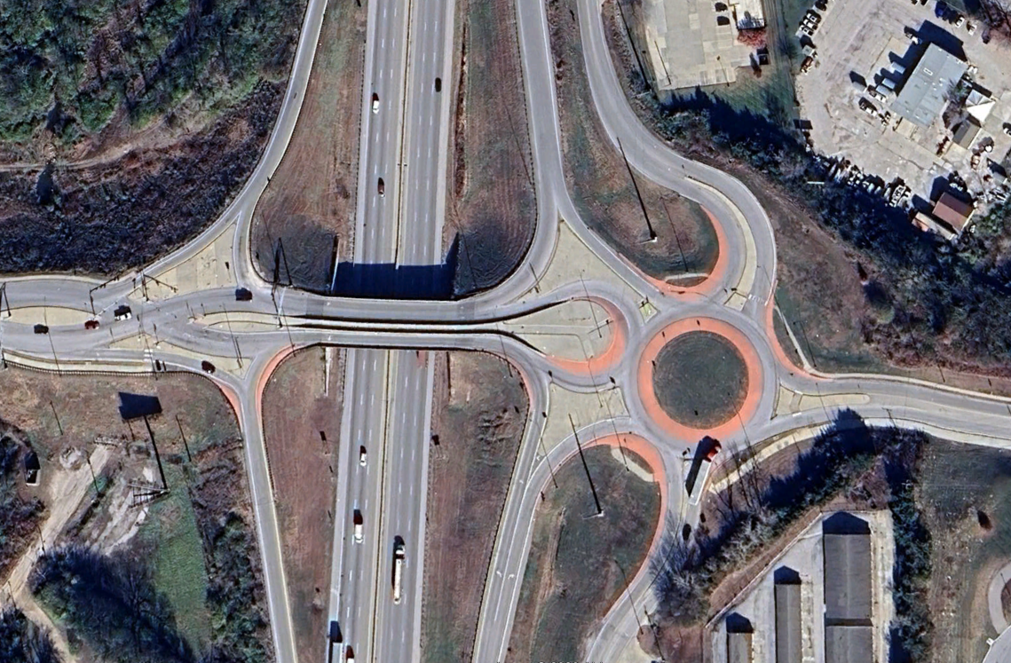
Questions?

